Slide 1
Data Mining Topic: Classification Introduction
Dr. J Angel Arul Jothi
Department of Computer Science

Slide 2
Text Book Chapter 4

Slide 3
Classification
Given a collection of records (training set)
Each record is characterized by a tuple (x, y)
x is the attribute set
y is the class label
Class label is discrete valued (categorical or nominal)
Task:
Learn a classification model that maps each attribute set x into one of the predefined class labels y

Slide 4
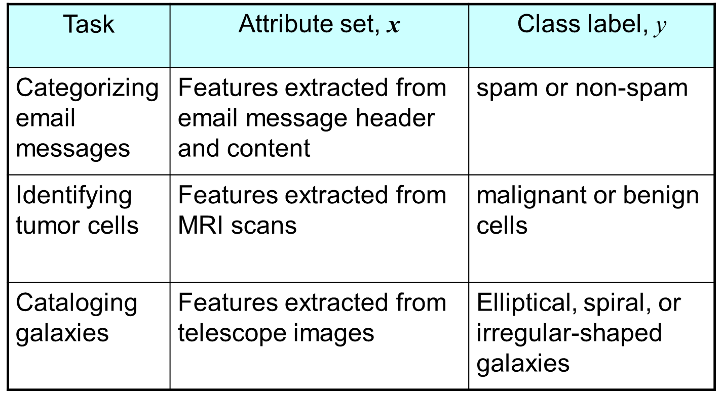
Examples

Slide 5
General Approach for Building Classification Model
A classification technique (or classifier) is a systematic approach to build classification models from an input data set
Examples include decision tree classifiers, rule-based classifiers, neural networks, support vector machines, and naive Bayes classifiers
Each technique employs a learning algorithm to identify a model that best fits the relationship between the attribute set and class label of the input data
The model generated by a learning algorithm should both fit the input data well and correctly predict the class labels of records it has never seen before
Therefore, a key objective of the learning algorithm is to build models with good generalization capability; i.e., models that accurately predict the class labels of previously unknown records

Slide 6
General Approach for Building Classification Model

Slide 7
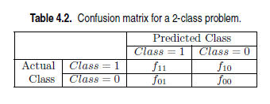
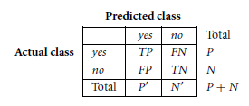

Metrics for Evaluating Classifier Performance

Slide 8
Metrics for Evaluating Classifier Performance
True positives (TP): These refer to the positive tuples that were correctly labeled by the classifier
True negatives (TN): These are the negative tuples that were correctly labeled by the classifier
False positives (FP): These are the negative tuples that were incorrectly labeled as positive
False negatives (FN): These are the positive tuples that were mislabeled as negative
Positive tuples (tuples of the main class of interest ex. Spam/malignant cells) and negative tuples (all other tuples ex. Not spam/benign cells)

Slide 9
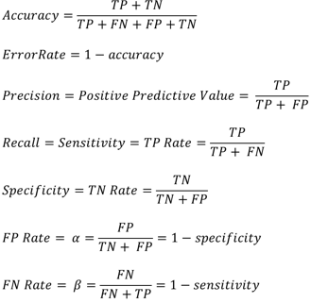
Metrics for Evaluating Classifier Performance
 | PREDICTED CLASS
ACTUAL CLASS |  | + | -
 | + | TP | FN
 | - | FP | TN

Slide 10
Metrics for Evaluating Classifier Performance
Precision can be thought of as a measure of exactness
what percentage of tuples labeled as positive are actually positive
Recall is a measure of completeness
what percentage of positive tuples are labeled as positive

Slide 11

Metrics for Evaluating Classifier Performance
The following figure shows a confusion matrix for medical data where the class values are yes and no for a class label attribute, cancer. Compute the various classifier evaluation measures.

Slide 12
Metrics for Evaluating Classifier Performance
Answer:
Sensitivity/TPR = recall = 90 / 300 = 30.00%.
Specificity/TNR = 9560 / 9700 =98.56%
FNR = 210/300 = 0.7 = (1-TPR)
FPR = 140/9700 = 0.014 = (1-TNR)
accuracy is 9650/10,000 = 96.50%
precision = 90/230 = 39.13%
F1 = 2 * 0.39 * 0.30 /0.69 = 0.34

Slide 13
Metrics for Evaluating Classifier Performance
Let actual and predicted denote the actual and predicted class label for a binary classification. Let 1 denote the positive class and 0 denote the negative class.
actual = [1, 1, 0, 1, 0, 0, 1, 0, 0, 0]
predicted = [1, 0, 0, 1, 0, 0, 1, 1, 1, 0]
Compute the classifier evaluation metrics and draw confusion matrix
TP = 3
TN = 4
FP = 2
FN = 1
 | Predicted
Actual | class | 1 | 0
 | 1 | 3 | 1
 | 0 | 2 | 4

Slide 14
Metrics for Evaluating Classifier Performance
Answer:
Accuracy = 7/10 = 0.7
Sensitivity/Recall/TPR = 3/4 = 0.75
Specificity/TNR = 4/6 = 0.66
FNR = 1- 0.75 = 0.25
FPR = 1-0.66 = 0.34
Precision = 3/5 = 0.6
F-measure = 2*(0.6 *0.75) / (0.6+0.75) =0.66

Slide 15
Confusion Matrix for multiclass classification
Assume there are 4 classes A, B, C, D.
INTERPRETATION FOR CLASS A
 |  | PREDICTED
ACTUAL |  | A | B | C | D
 | A | TP (A) | FN (A) | FN (A) | FN (A)
 | B | FP (A) | TN | TN | TN
 | C | FP (A) | TN | TN | TN
 | D | FP (A) | TN | TN | TN

Slide 16
Confusion Matrix for multiclass classification
INTERPRETATION FOR CLASS B
 |  | PREDICTED
ACTUAL |  | A | B | C | D
 | A | TN | FP | TN | TN
 | B | FN | TP | FN | FN
 | C | TN | FP | TN | TN
 | D | TN | FP | TN | TN

Slide 17
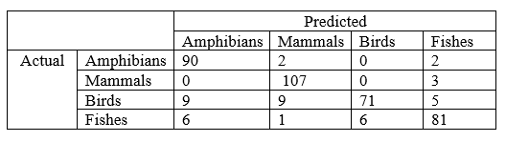
Confusion Matrix for multiclass classification
The table below is the confusion matrix obtained for a classifier for a 4-class classification problem. The four classes are Amphibians, Mammals, Birds and Fishes.
Compute the Specificity for the Mammals class
Compute the F1-score for the Birds class
Compute the FP Rate for the Fishes class
Compute the FN Rate for the Mammals class
Compute the Sensitivity for the Amphibians class
Compute the error rate of the classifier

Slide 18
Confusion Matrix for multiclass classification
ANSWERS
TN = 270, FP = 12, Specificity = 0.95
TP = 71, FN = 23, Precision = 0.92, Recall = 0.75, F1-score = 0.83
FP = 10, TN = 288, FP rate = 0.033
FN = 3, TP = 107, FN Rate = 0.027
TP = 90, FN = 4, Sensitivity = 0.95
No. of correction predictions = 349, Total predictions = 392, Error rate = 0.11

Slide 19
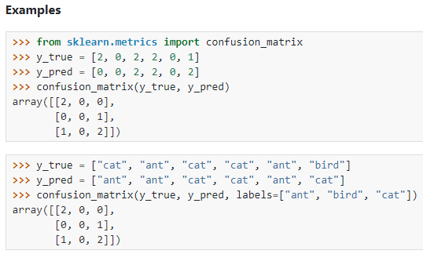
Confusion matrix sklearn
y_true = actual class labels
y_pred = predicted class labels

Slide 20

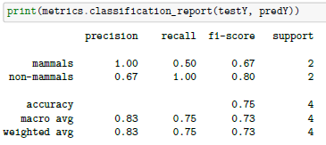
classification_report of sklearn
testY = actual class labels
predY = predicted class labels
P(mammals) = 2, N(non-mammals) =2

Slide 21


Macro average precision & recall
The macro average precision is the arithmetic mean of the precision scores of all classes.
The macro average recall is the arithmetic mean of recall scores of all classes.
The macro average F1 is the arithmetic mean of F1 scores of all classes.

Slide 22
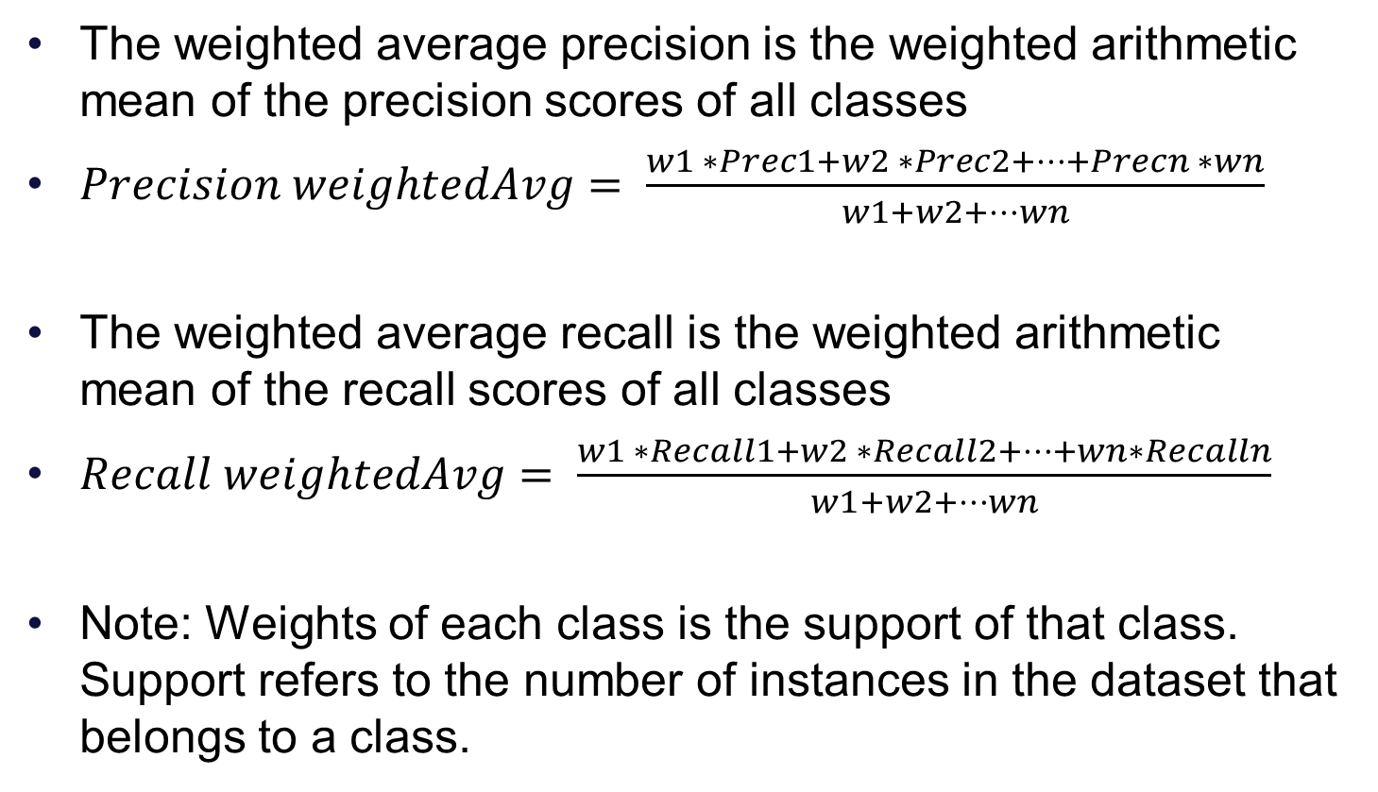
Weighted average precision & recall
The weighted average precision is the weighted arithmetic mean of the precision scores of all classes
$Precision weightedAvg= \frac{w1 ∗Prec1+w2 ∗Prec2+…+Precn ∗wn}{w1+w2+…wn}$
The weighted average recall is the weighted arithmetic mean of the recall scores of all classes
$Recall weightedAvg= \frac{w1 ∗Recall1+w2 ∗Recall2+…+wn∗Recalln}{w1+w2+…wn}$
Note: Weights of each class is the support of that class. Support refers to the number of instances in the dataset that belongs to a class.

Slide 23
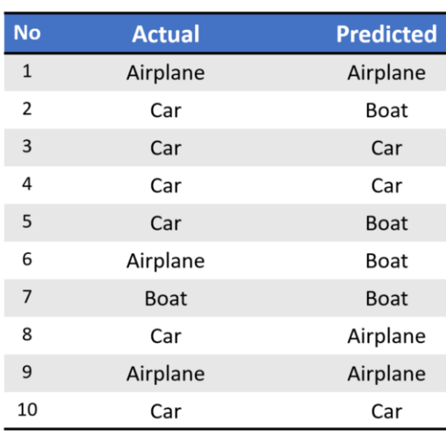
Example
Classes: Aeroplane, Car, Boat
Support: 3, 6, 1 respectively

Slide 24
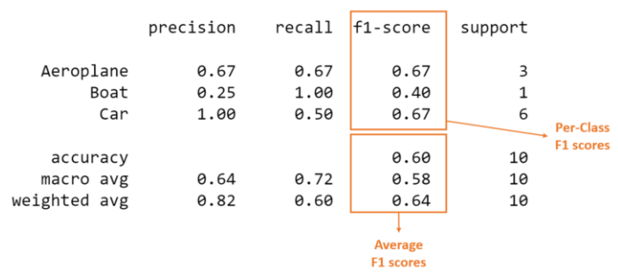
Classification Report

Slide 25
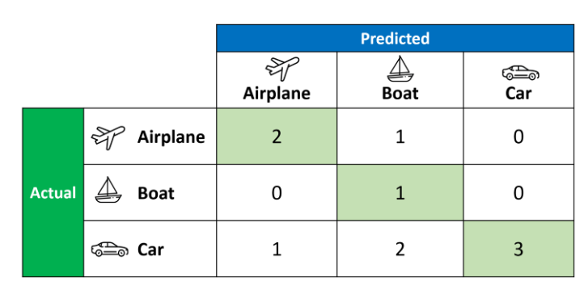
Confusion Matrix

Slide 26
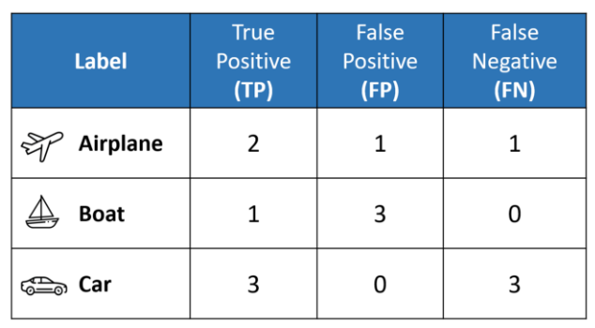
Calculated TP, FP, and FN values from confusion matrix

Slide 27
classification_report of sklearn
macro-average: It is calculated as arithmetic mean of individual classes’ metric values
Weighted average: It is calculated as the weighted arithmetic mean of individual classes’ metric values. The weights are nothing but the support count of each class
micro-average: It is calculated from the individual classes’ true positives (TPs), true negatives (TNs), false positives (FPs), and false negatives (FNs) of the model

Slide 28
classification_report of sklearn
micro-averaging provides equal weight for each instance or sample
macro-averaging treats all classes equally
weighted macro-averaging score is used in case of class imbalances

Slide 29
Classification Techniques
Decision Tree based Methods
Rule-based Methods
Memory based reasoning
Neural Networks
Naïve Bayes and Bayesian Belief Networks
Support Vector Machines

Slide 30
Thank you

